Slide 1
Numerical Methods in Engineering and Applied Science
Project
Oscillator networks
Synchronization of oscillators, a phenomenon found in a wide variety of natural and engineered systems, is typically understood through a reduction to a first-order phase model with simplified dynamics. Here I examined the dynamics of a ring of quasi-sinusoidal oscillators beyond first order. Beyond first order, i found exotic states of synchronization with highly complex dynamics, including weak chimeras, decoupled states, and inhomogeneous synchronized states.

Slide 2
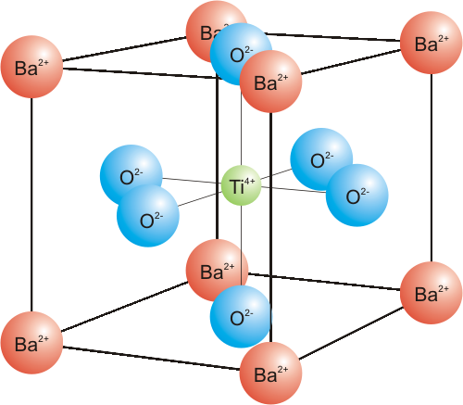

Slide 3
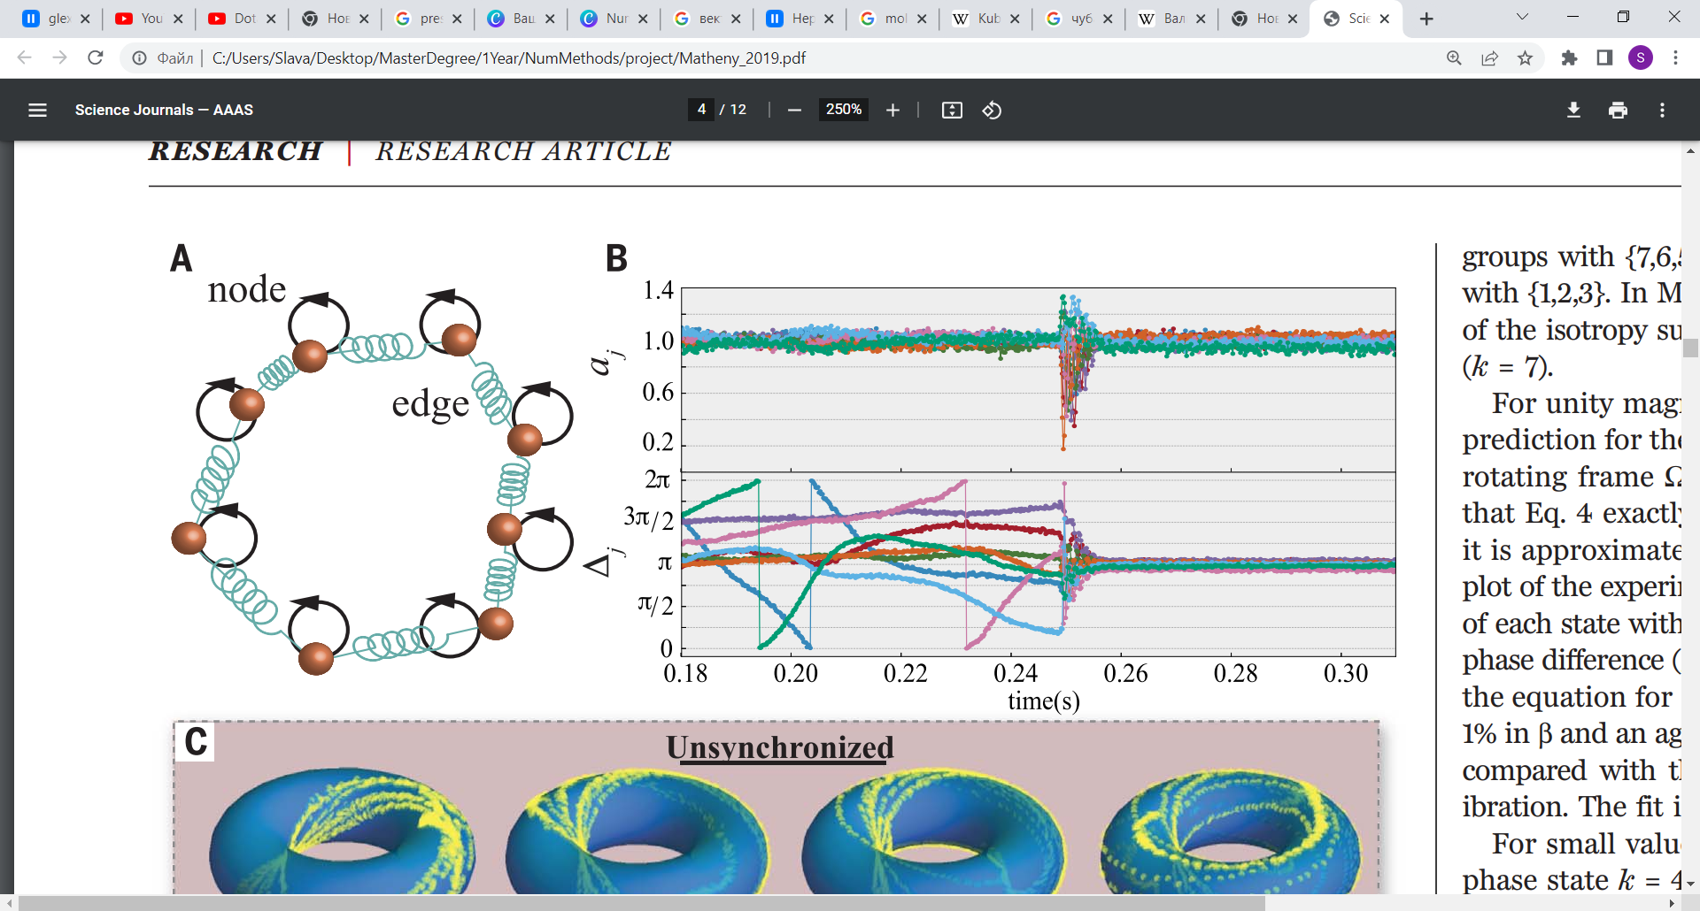
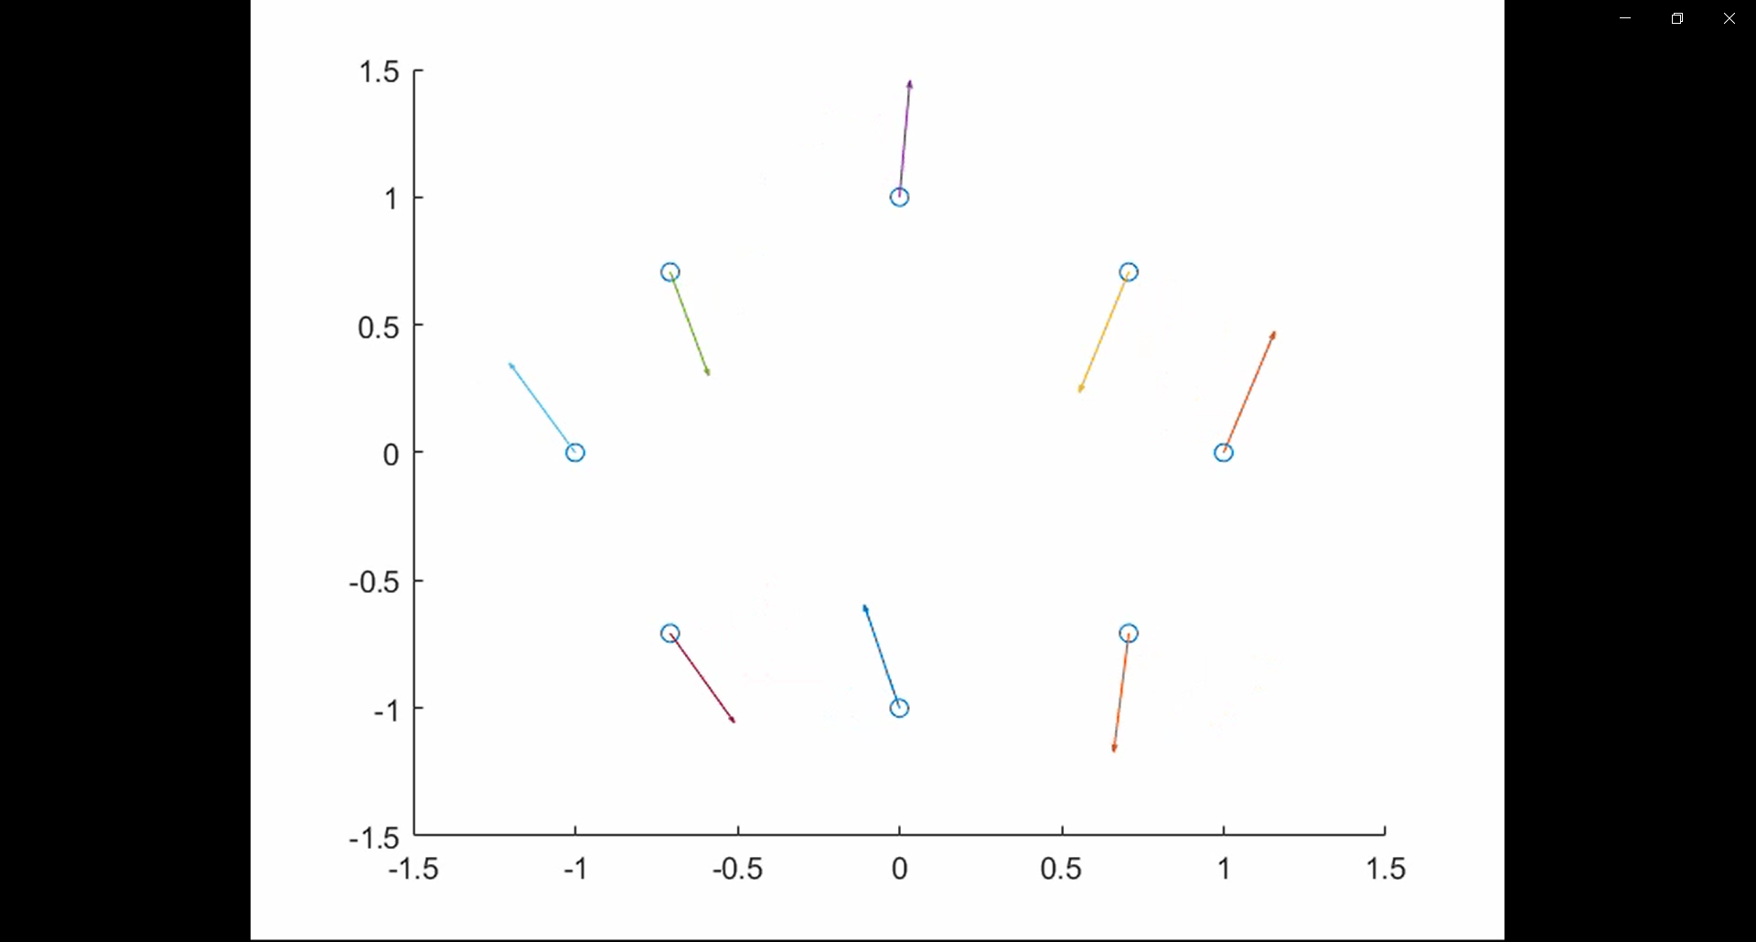
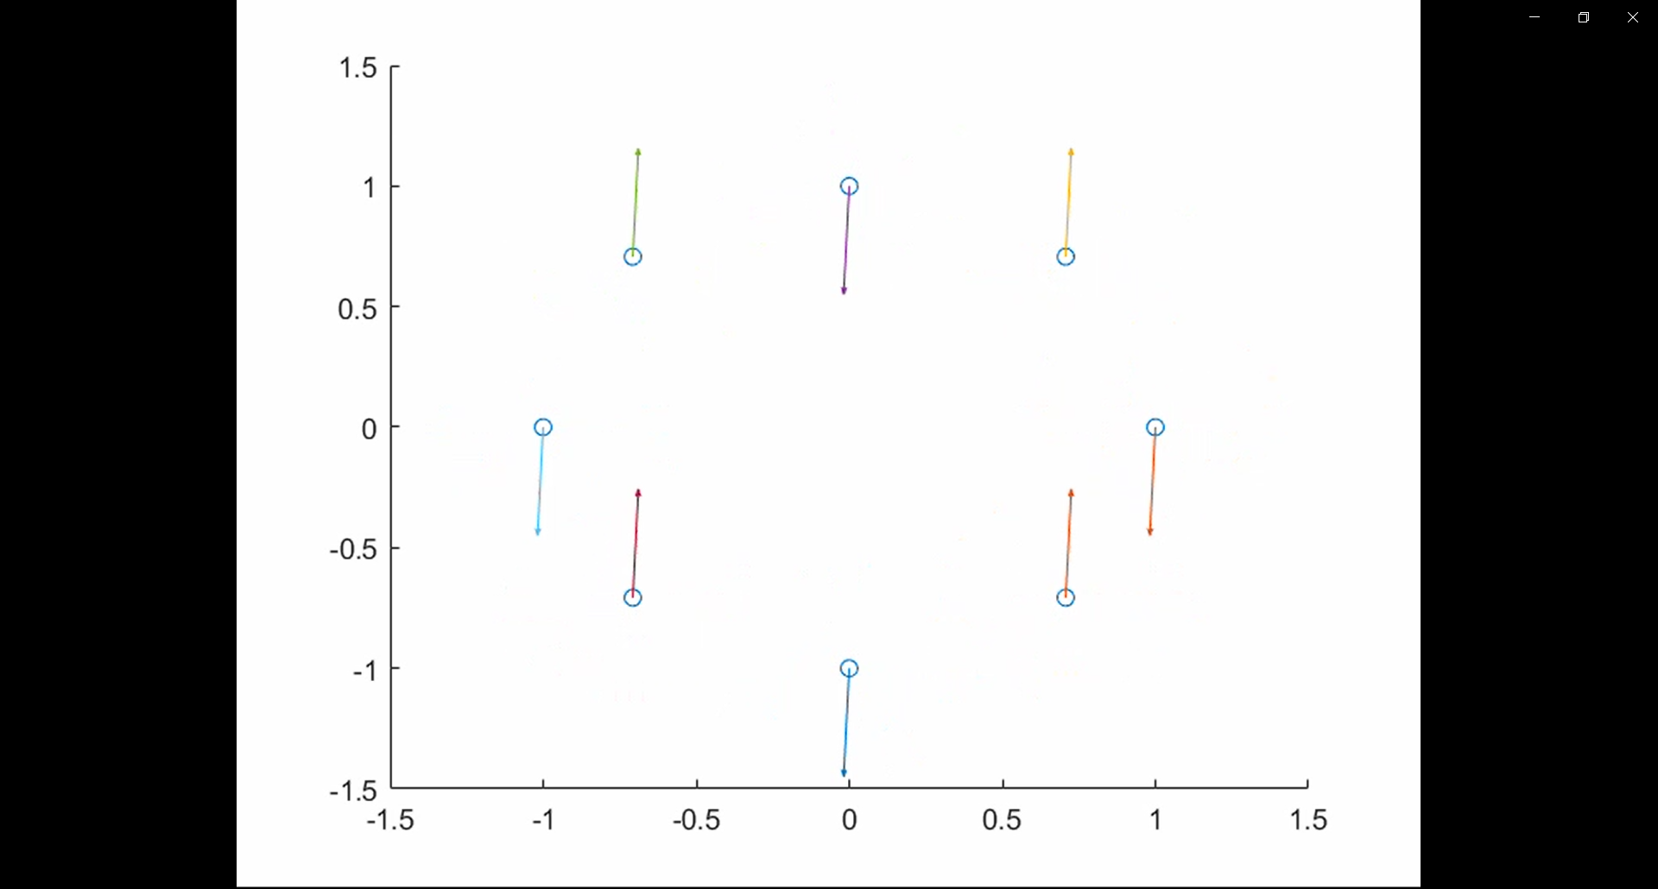

Slide 4
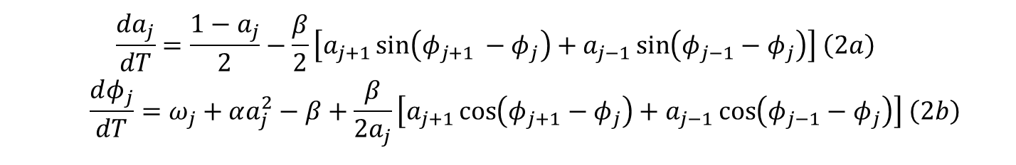
$$\begin{aligned}&\frac{dA_{j}}{dT}=−\frac{A_{j}}{2}+\frac{A_{j}}{2\left|A_{j}\right|}+i\left[ω_{j}A_{j}+α{\left|A_{j}\right|}^{2}A_{j}\right]−iβA_{j}+i\frac{β}{2}\left(A_{j−1}+A_{j+1}\right) \#\left(1\right)\end{aligned}$$
$$\begin{aligned}\frac{da_{j}}{dT}=\frac{1−a_{j}}{2}−\frac{β}{2}\left[a_{j+1}\sin\left(φ_{j+1 }−φ_{j}\right)+a_{j−1}\sin\left(φ_{j−1}−φ_{j}\right)\right] \#\left(2a\right)\end{aligned}$$
$$\begin{aligned}\frac{dφ_{j}}{dT}=ω_{j}+αa_{j}^{2}−β+\frac{β}{2a_{j}}\left[a_{j+1}\cos\left(φ_{j+1}−φ_{j}\right)+a_{j−1}\cos\left(φ_{j−1}−φ_{j}\right)\right] \#\left(2b\right)\end{aligned}$$

Slide 5
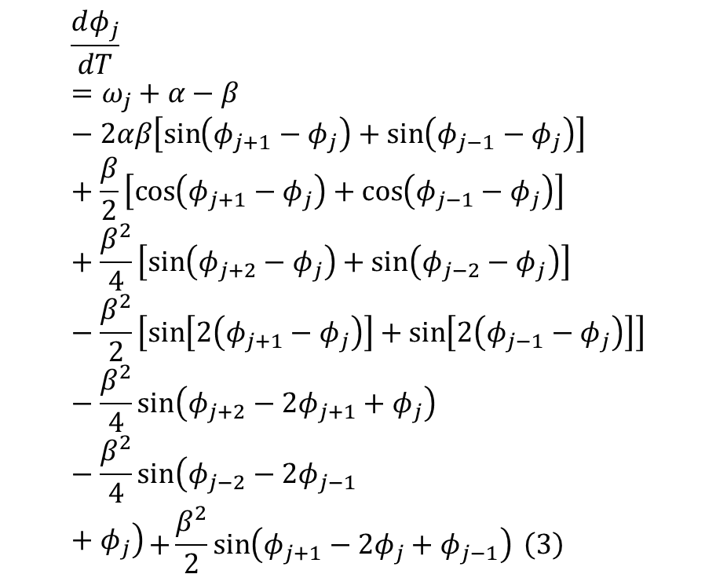
$$\frac{dφ_{j}}{dT}=ω_{j}+α−β−2αβ\left[\sin\left(φ_{j+1}−φ_{j}\right)+\sin\left(φ_{j−1}−φ_{j}\right)\right] +\frac{β}{2}\left[\cos\left(φ_{j+1}−φ_{j}\right)+\cos\left(φ_{j−1}−φ_{j}\right)\right]+\frac{β^{2}}{4}\left[\sin\left(φ_{j+2}−φ_{j}\right)+\sin\left(φ_{j−2}−φ_{j}\right)\right]−\frac{β^{2}}{2}\left[\sin\left[2\left(φ_{j+1}−φ_{j}\right)\right]+\sin\left[2\left(φ_{j−1}−φ_{j}\right)\right]\right]−\frac{β^{2}}{4}\sin\left(φ_{j+2}−2φ_{j+1}+φ_{j}\right)−\frac{β^{2}}{4}\sin\left(φ_{j−2}−2φ_{j−1}+φ_{j}\right)\begin{aligned}&+\frac{β^{2}}{2}\sin\left(φ_{j+1}−2φ_{j}+φ_{j−1}\right) \#\left(3\right)\end{aligned}$$
$$\begin{aligned}&\frac{dφ_{j}}{dT}=ω_{j}+α+K\sum_{i=j−1,j+1}{\left\{\sin\left(φ_{i}−φ_{j}\right)+γ\left[1−\cos\left(φ_{i}−φ_{j}\right)\right]\right\}} \#\left(4\right)\end{aligned}$$

Slide 6
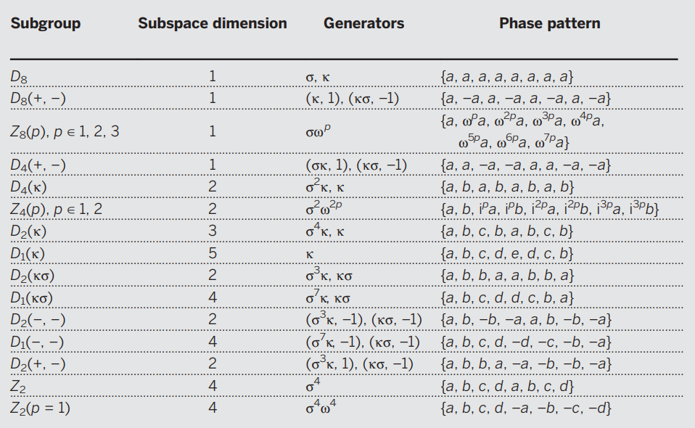

Slide 7
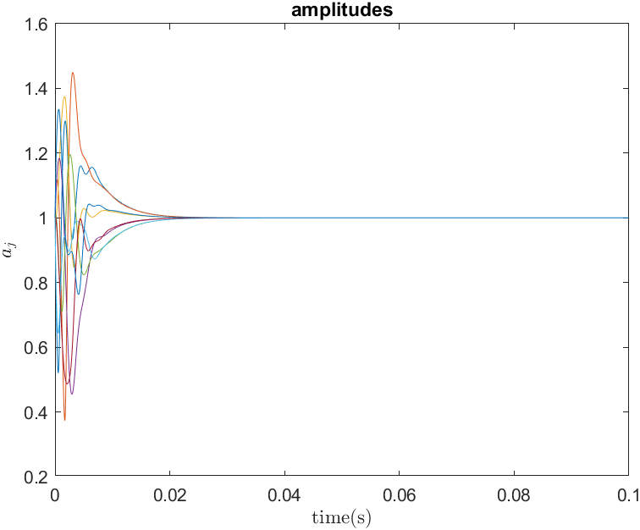
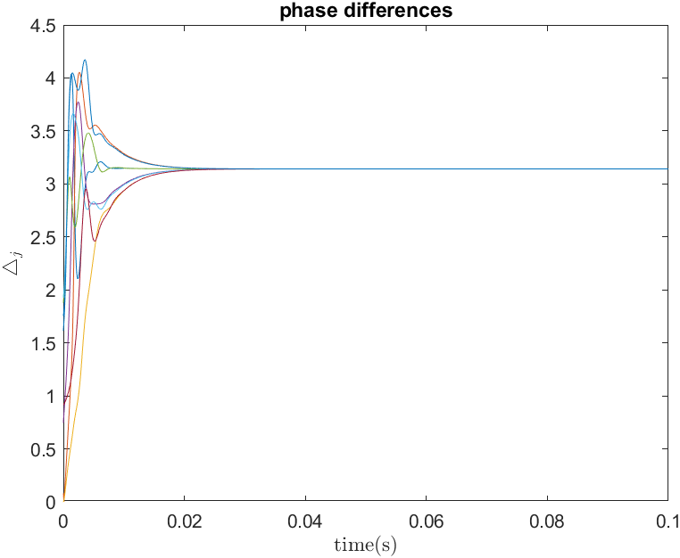
$$∆_{j}=\left(φ_{j+1 }−φ_{j}\right)mod\left(2π\right)$$

Slide 8
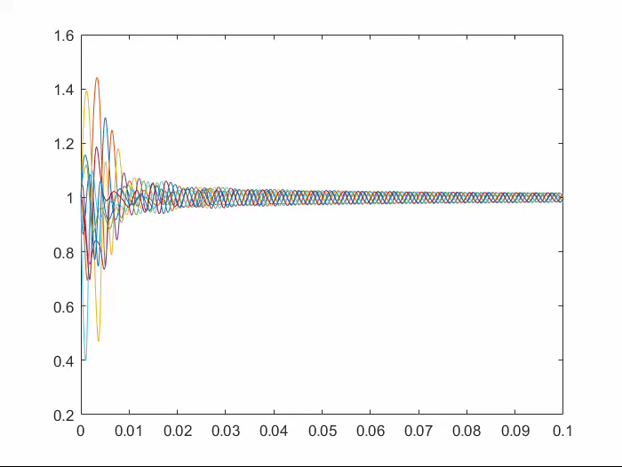
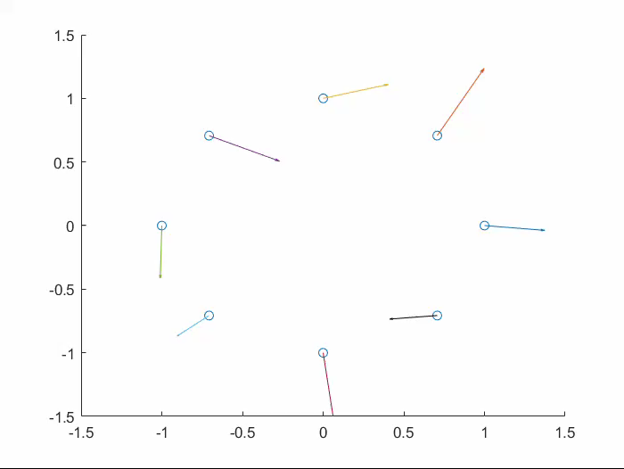

$$\begin{aligned}&k=\frac{1}{2π}\sum_{j=1}^{N}{∆_{j}} ,k=0,…N−1 \#\left(5\right)\end{aligned}$$

Slide 9
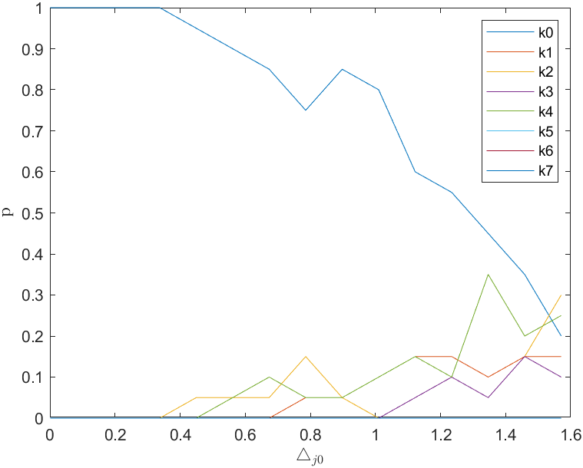



$$\left.φ_{1}−φ_{2}∈[−∆_{10},∆_{10}\right]$$
$$\begin{aligned}&k=\frac{1}{2π}\sum_{j=1}^{N}{∆_{j}} ,k=0,…N−1 \#\left(5\right)\end{aligned}$$
$$\begin{aligned}&∆_{j}=\frac{πk}{4}, k=0,…N−1 \#\left(5^{∗}\right)\end{aligned}$$

Slide 10
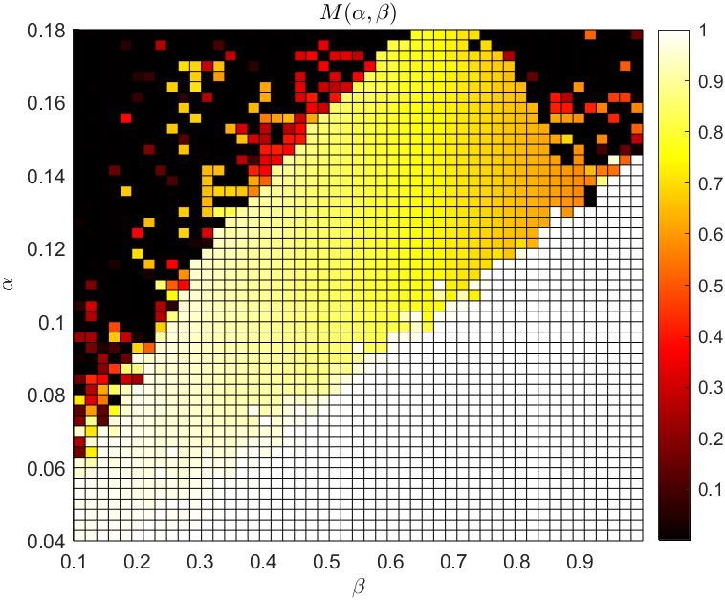

$∆_{j0}∈[−\frac{π}{20};\frac{π}{20}]$.
$$α∈\left[0.04,0.18\right], β∈\left[0.1,1\right]$$
$$Mexp\left(iΦ\right)=\frac{1}{N}\sum_{j=1}^{N}{\exp\left(iφ_{j}\right)}$$
if $M <0.5$ it is other synchronized state (black and red $\{k=1,2,…7\}$)
If $M=1$ then our nodes in-phase (white$\{k=0\}$)
if $0.5<M<1$ it is imhomogeneous synchronization

Slide 11
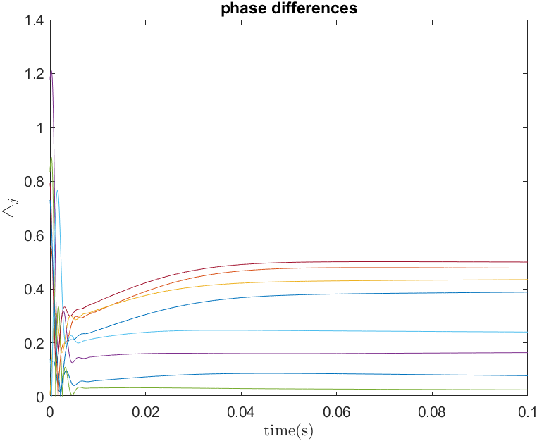
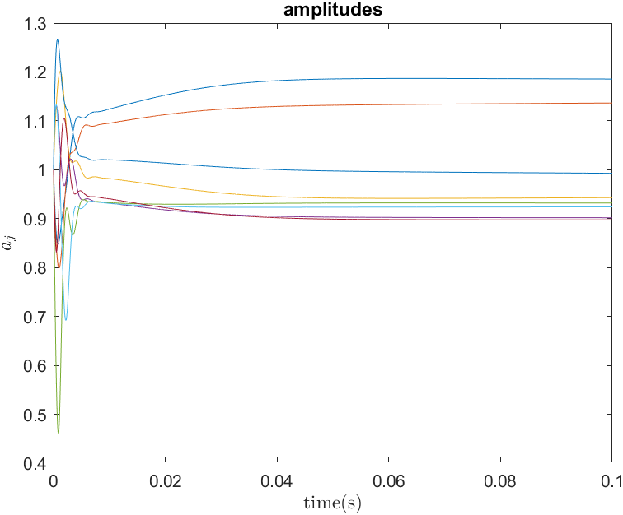
A lot of experimental results shows that states with both a coherent synchronized region and an incoherent region are possible. Also called weak chimeras.

Slide 12
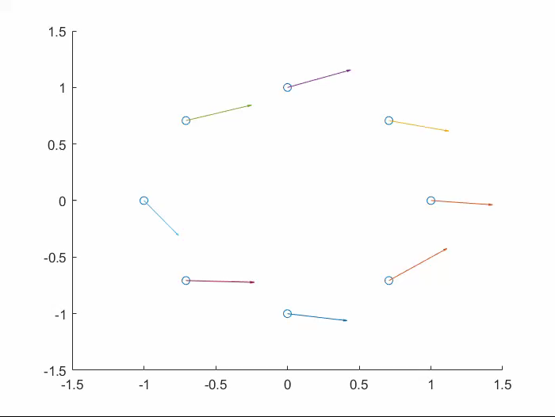

Slide 13
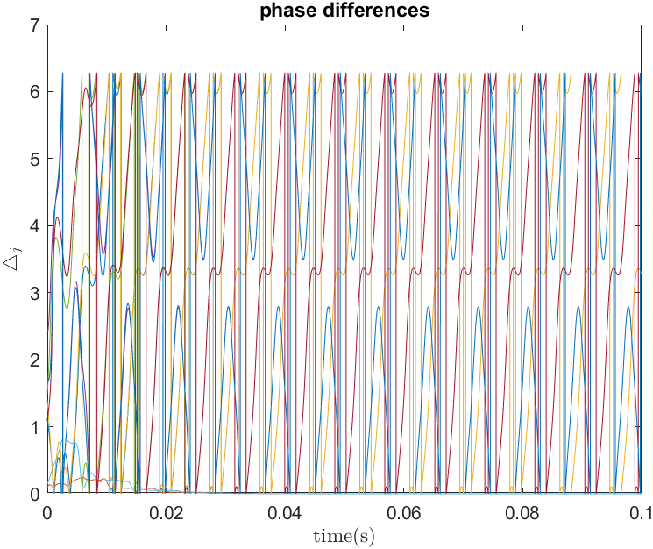
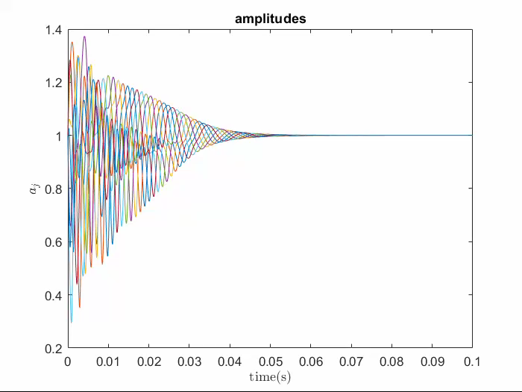
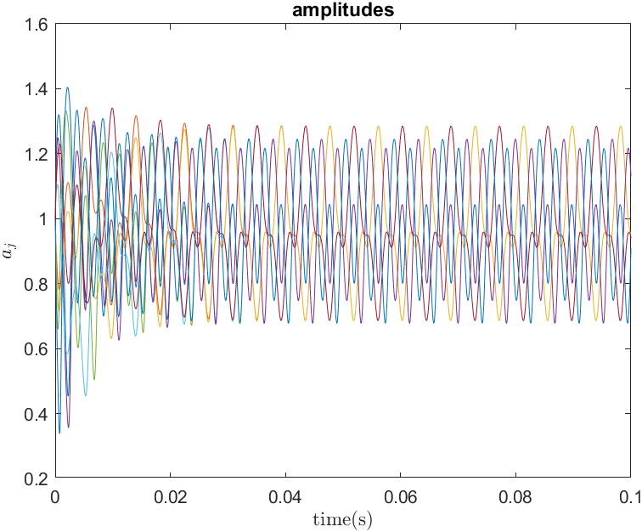
I demonstrated that a simple ring of eight self-sustained nanoelectromechanical oscillators with linear, nearest-neighbor coupling exhibits exotic states of synchronization with complex dynamics and broken symmetries.

